Slide 1

RETAIL STORE SALES
DATA CLEANUP & VISUALIZATION

Slide 2
BEFORE WE GO
Greetings and welcome! In this presentation, I'll walk you through the sales performance of our company in 2010 and 2011. I want to express my gratitude for entrusting me with the task of delving into this data to extract valuable insights about our store's performance.
Additionally, I'd like to extend my appreciation for the thoughtful questions you've posed, as they've guided the analysis toward the specific insights you're seeking.

Slide 3
APPROACH
In this project, I've meticulously handled data cleaning to ensure that our dataset is pristine and ready for visualization.
This involved the removal of any negative values found in the unit price and quantity columns, as well as applying necessary filters to streamline the data for our visualization needs .

Slide 4
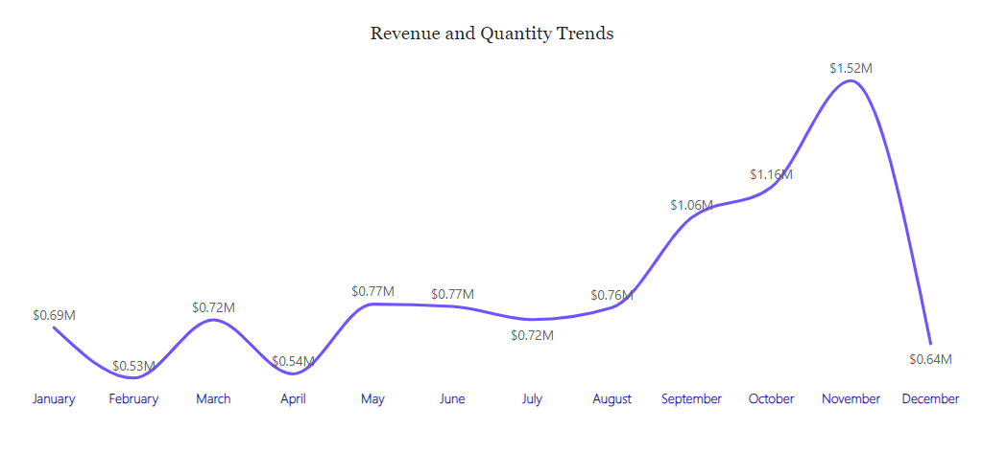
QUESTION 1
INSIGHTS
The CEO of the retail store is interested to view the time series of the revenue data for the year 2011 only. He would like to view granular data by looking into revenue for each month. The CEO is interested in viewing the seasonal trends and wants to dig deeper into why these trends occur. This analysis will be helpful for the CEO to forecast for the next year.
The initial 8 months showed consistent monthly revenues, averaging around $685,000.
However, a remarkable surge began in September, reaching its pinnacle at $1.52 million in November, with an average monthly revenue increase of approximately 21.18% from August to November.
This revenue pattern from August to December highlights the significant impact of seasonal factors on our retail store sales.

Slide 5
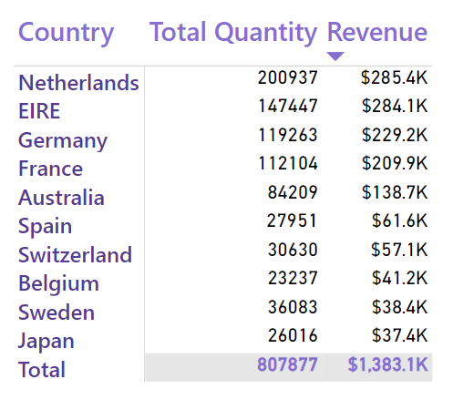
QUESTION 2
INSIGHTS
The CMO is interested in viewing the top 10 countries which are generating the highest revenue. Additionally, the CMO is also interested in viewing the quantity sold along with the revenue generated. The CMO does not want to have the United Kingdom in this visual.
This chart displays the top 10 countries by revenue and the quantities of goods purchased, excluding the United Kingdom.
Interestingly, there are no significant disparities between the revenue and the quantity of goods sold in these countries, indicating a strong purchasing power across this group.

Slide 6
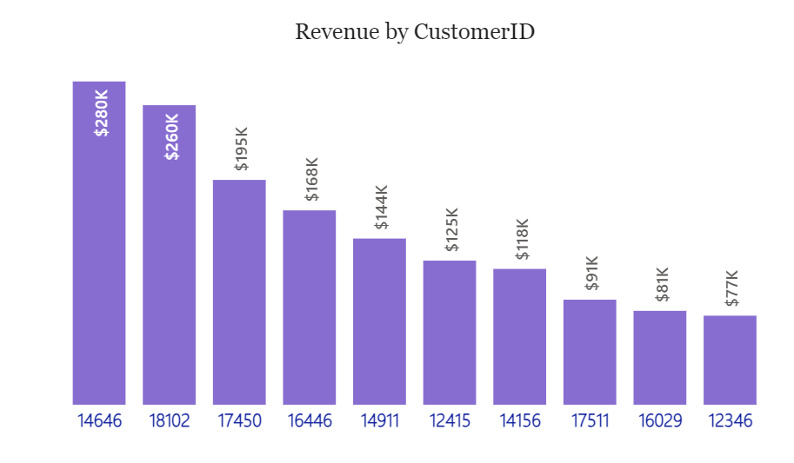
QUESTION 3
INSIGHTS
The CMO of the online retail store wants to view the information on the top 10 customers by revenue. He is interested in a visual that shows the greatest revenue generating customer at the start and gradually declines to the lower revenue generating customers. The CMO wants to target the higher revenue generating customers and ensure that they remain satisfied with their products.
This chart highlights a notable similarity among the top 10 customers in terms of revenue generated.
The average difference in revenue between these top customers is just 15.8%.
To capitalize on this consistency, the company has a great opportunity to bolster relationships with these customers, fostering loyalty and retention. This strategy can ultimately lead to increased sales and revenue for the company.

Slide 7
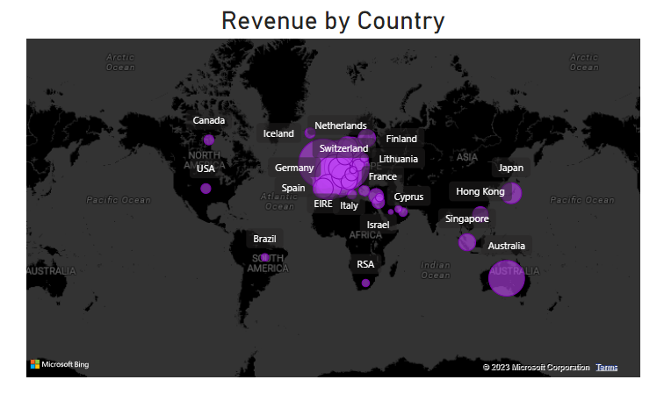
QUESTION 4
INSIGHTS
The CEO is looking to gain insights on the demand for their products. He wants to look at all countries and see which regions have the greatest demand for their products. Once the CEO gets an idea of the regions that have high demand, he will initiate an expansion strategy which will allow the company to target these areas and generate more business from these regions. He wants to view the entire data on a single view without the need to scroll or hover over the data points to identify the demand. There is no need to show data for the United Kingdom as the CEO is more interested in viewing the countries that have expansion opportunities.
The Map chart draws a clear distinction between areas that have generated significant revenue and those that haven’t.
This map also reveals that the majority of sales are concentrated in the European zone, with a smaller presence in the American region and Russia. Interestingly, there seems to be little to no market for these items in Africa or Asia.

Slide 8
SUGGESTIONS
The company should focus on stocking and promoting seasonal products to capitalize on increased demand during specific times of the year.
A more comprehensive analysis of high-demand products during low sales months can inform targeted marketing strategies.
Examining product types and their regional revenue contributions will guide region-specific marketing efforts.
Incentivizing top revenue-generating customers can strengthen these valuable relationships.
The European market offers growth potential, so strategic initiatives to enhance the company's position there should be a priority.

Slide 9
THANK YOU

